Slide 1
Methods
Disclaimer: The following presentation contains materials that can be upsetting for some. As the following contains real world examples of hate speech, viewers are recommended to proceed with caution.

Slide 2
Key Questions
What are the impacts of hate speech on those receiving it?
Why do individuals engage in hate speech?
Are there any ongoing trends in individuals who practice hate speech?
How quickly is hate speech being circulated in online circles?
Can we predict the future acts of hateful individuals and hate groups and how?
Notes:
When beginning to take on the task of analyzing hate speech, it is important to establish the questions that you want guiding your research.

Slide 3
Keyword Identification
A review on how to identify hate speech through keyword recall, as well as the suggested lexicons used to perform hate speech research.

Slide 4
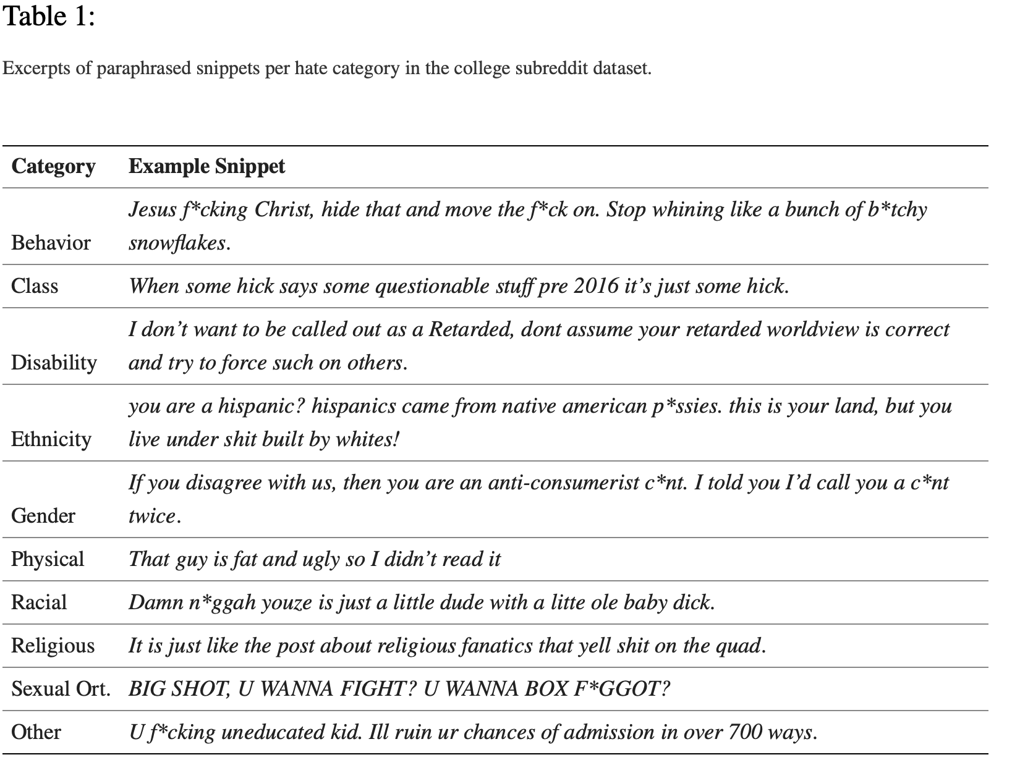
Keyword Identification
Keyword identification can either be done manually - as common with many social media sites like Twitter and Facebook - or researchers can use a machine learning model for automated identification.
”We adopt a pattern (keyword) matching approach by using a high-precision lexicon from two research studies on hateful speech and social media. This lexicon was curated after multiple iterations of filtering through automated classification, followed by crowdsourced and expert inspection. It consists of 157 phrases that are categorized into: behavior, class, disability, ethnicity, gender, physical, race, religion, sexual orientation, and other.” (Saha et al., 2019, p. 257).
Notes:
Keyword identification remains a useful method of analyzing hate speech. For manual identification, researchers will use an established lexicon of terms, combing online flatforms for those keywords and phrases that alert the reader to the presence of hate speech. Manual identification is effective as multiple researchers can collaborate, using context and prior knowledge to identify hate speech. Yet for larger blocks of text, automated identification proves useful as it allows researcher to look at a wider scope of data, and otherwise automates the process of combing through and selecting terms. Both have their merits, and their place within the research.

Slide 5
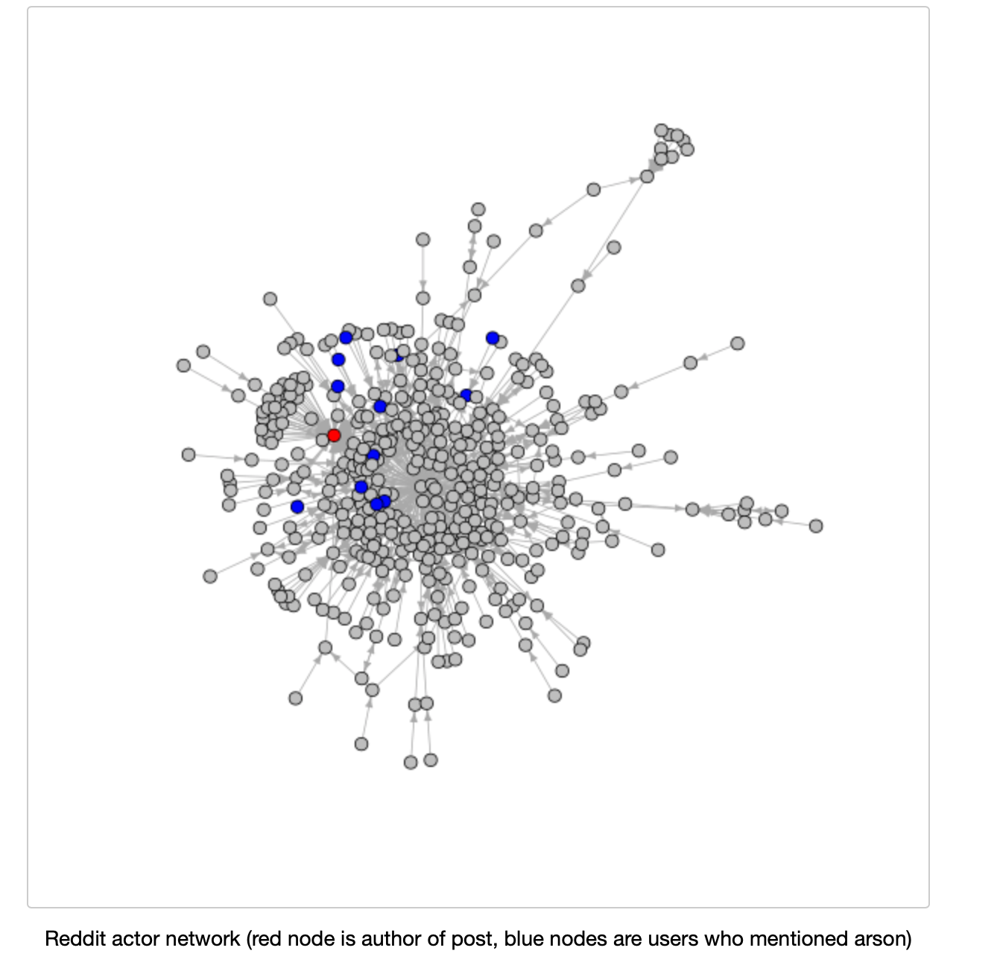
Archival Data Gathering
- VOSONsml
“The processing of page text content is conducted using two methods: page meta-data keywords are extracted using the web crawler; page text content is also optionally stored and then parsed using the Lingua::LinkParser 3 Perl module which is a front-end to the Link Grammar Parser software” (Ackland et al., 2006, p. 2).
Through the use of VOSONsml and similar text harvesting software, researchers can pull data from across different online platforms, and draw connections between the usages of select terms.
Notes:
A well developed text harvesting software, VOSONsml can extract keywords from digital spaces, thus automating the keyword identification process.

Slide 6
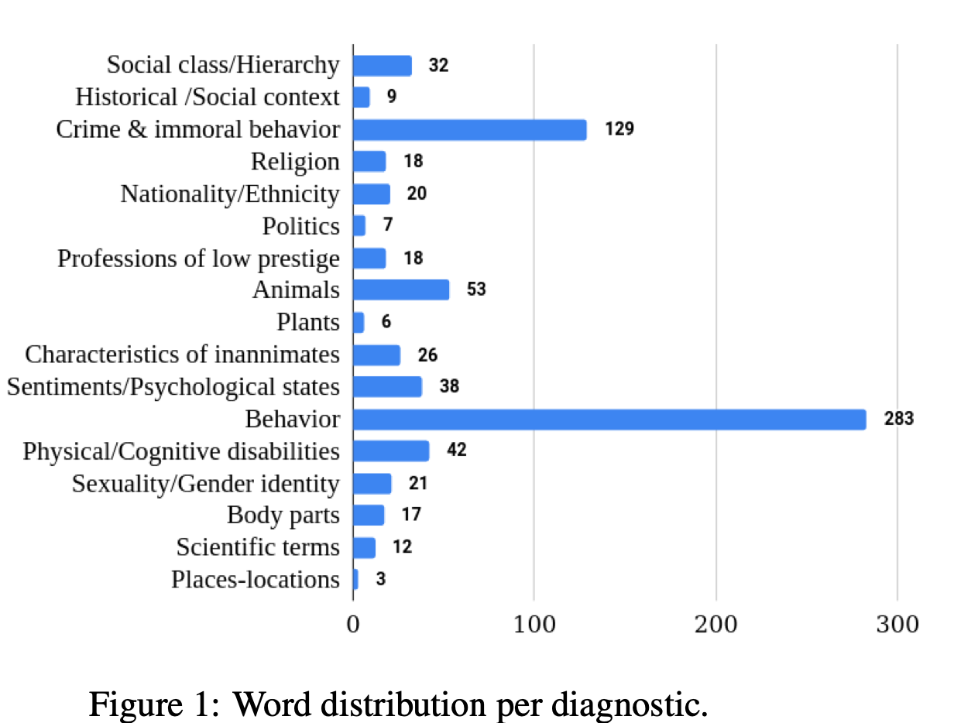
Hurtlex
“HURTLEX is a domain-independent lexicon of 53 languages with offensive, aggressive and hateful words. Its kernel consists of ∼1000 manually selected words corresponding to 17 fine-grained thematic categories that were enriched in a semi- automatic manner by drawing on the multiword net systems and babelnet” (Stamou et al., 2022, p. 103).
“Figure 1 presents the distribution of words per diagnostic. Behavior is the most populated diagnostic followed by Crime & immoral behavior and Animals” (Stamou et al., 2022, p. 105).
Notes:
Hurtlex’s lexicon includes categories that alert the user as to what demographic is specifically targeted by the hate speech. Knowing intent is useful for research purposes as it clues the reader into the motives and intentions of the speaker, as well as provides context for the speech itself.

Slide 7
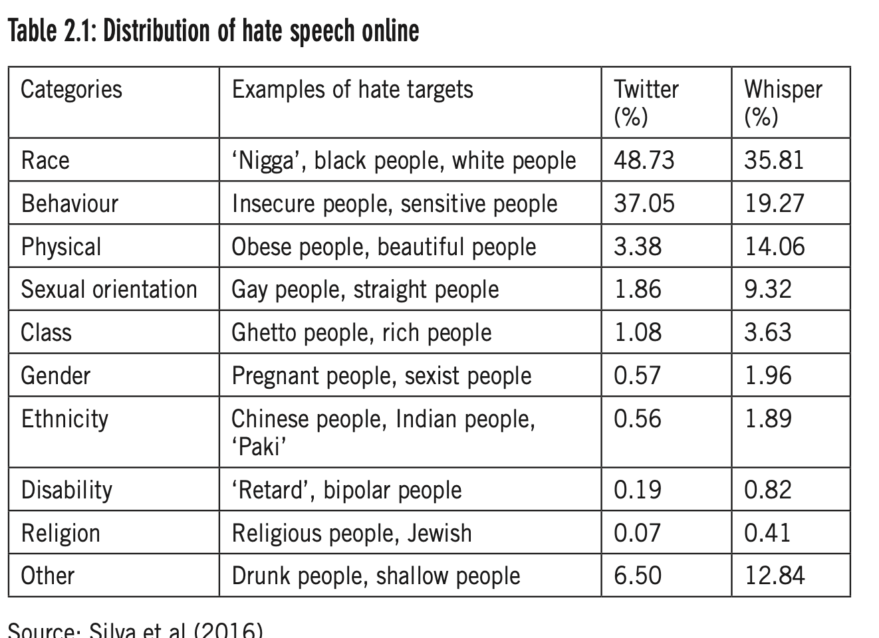
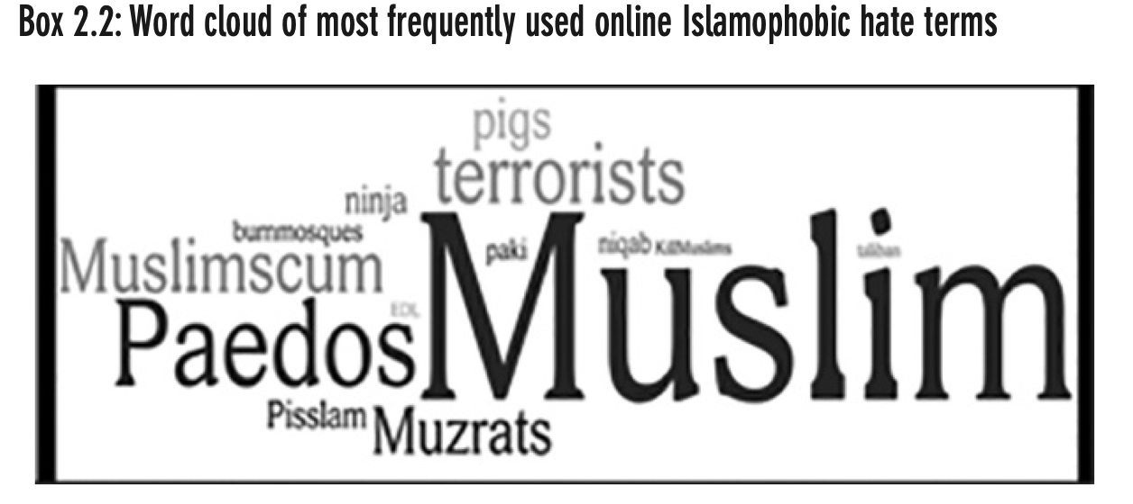
Hatebase
“Taking the specific case of Islamophobia, [and using terms from the ‘hatebase lexicon, the researcher] identified other types of actors in a random sample of 500 tweets from 100 different Twitter users using three hashtags that had ‘trended’ in 2013 in the UK (#Woolwich, #Muslim and #Islam)” (Chahal, 2017, p.23).
“Key terms were then categorised and the data was searched for frequencies of occurrence. The highest percentage of hate targets focused on race in both sites; over a third of posts in Whisper and almost half in twitter” (Chahal, 2017, p. 21).
Notes:
“Hatebase [is] a crowd-sourced database described as ‘the world’s largest online repository of structured, multilingual, usage-based hate speech” (Chahal, 2017)
Hatebase is a multilingual lexicon that takes into account the many facets of hate speech that exist in digital spaces. The terms present in Hatebase prove useful for keyword identification due to the broad scope of language provided, and the consistent updates to the lexicon that keep in relevant. Table 2.1 represents a categorization of key words collected from a year-long study involving Whisper posts and a 1% random sample from Twitter, from a study designed and run by Silvia et al. (2013). Box 2.2 represents a word cloud of the most frequently used online Islamophobic hate terms by a study designed and run by Awan (2014).

Slide 8
Online Exploration
Take this time to explore Hurtlex. Get familiar with its features, including how to find specific terms and phrases.
You can find HurtLex at:
https://github.com/valeriobasile/hurtlex

Slide 9
Analysis through Machine Learning Models
An overview of the different types of analyses that can be achieved through use of a machine learning model.

Slide 10
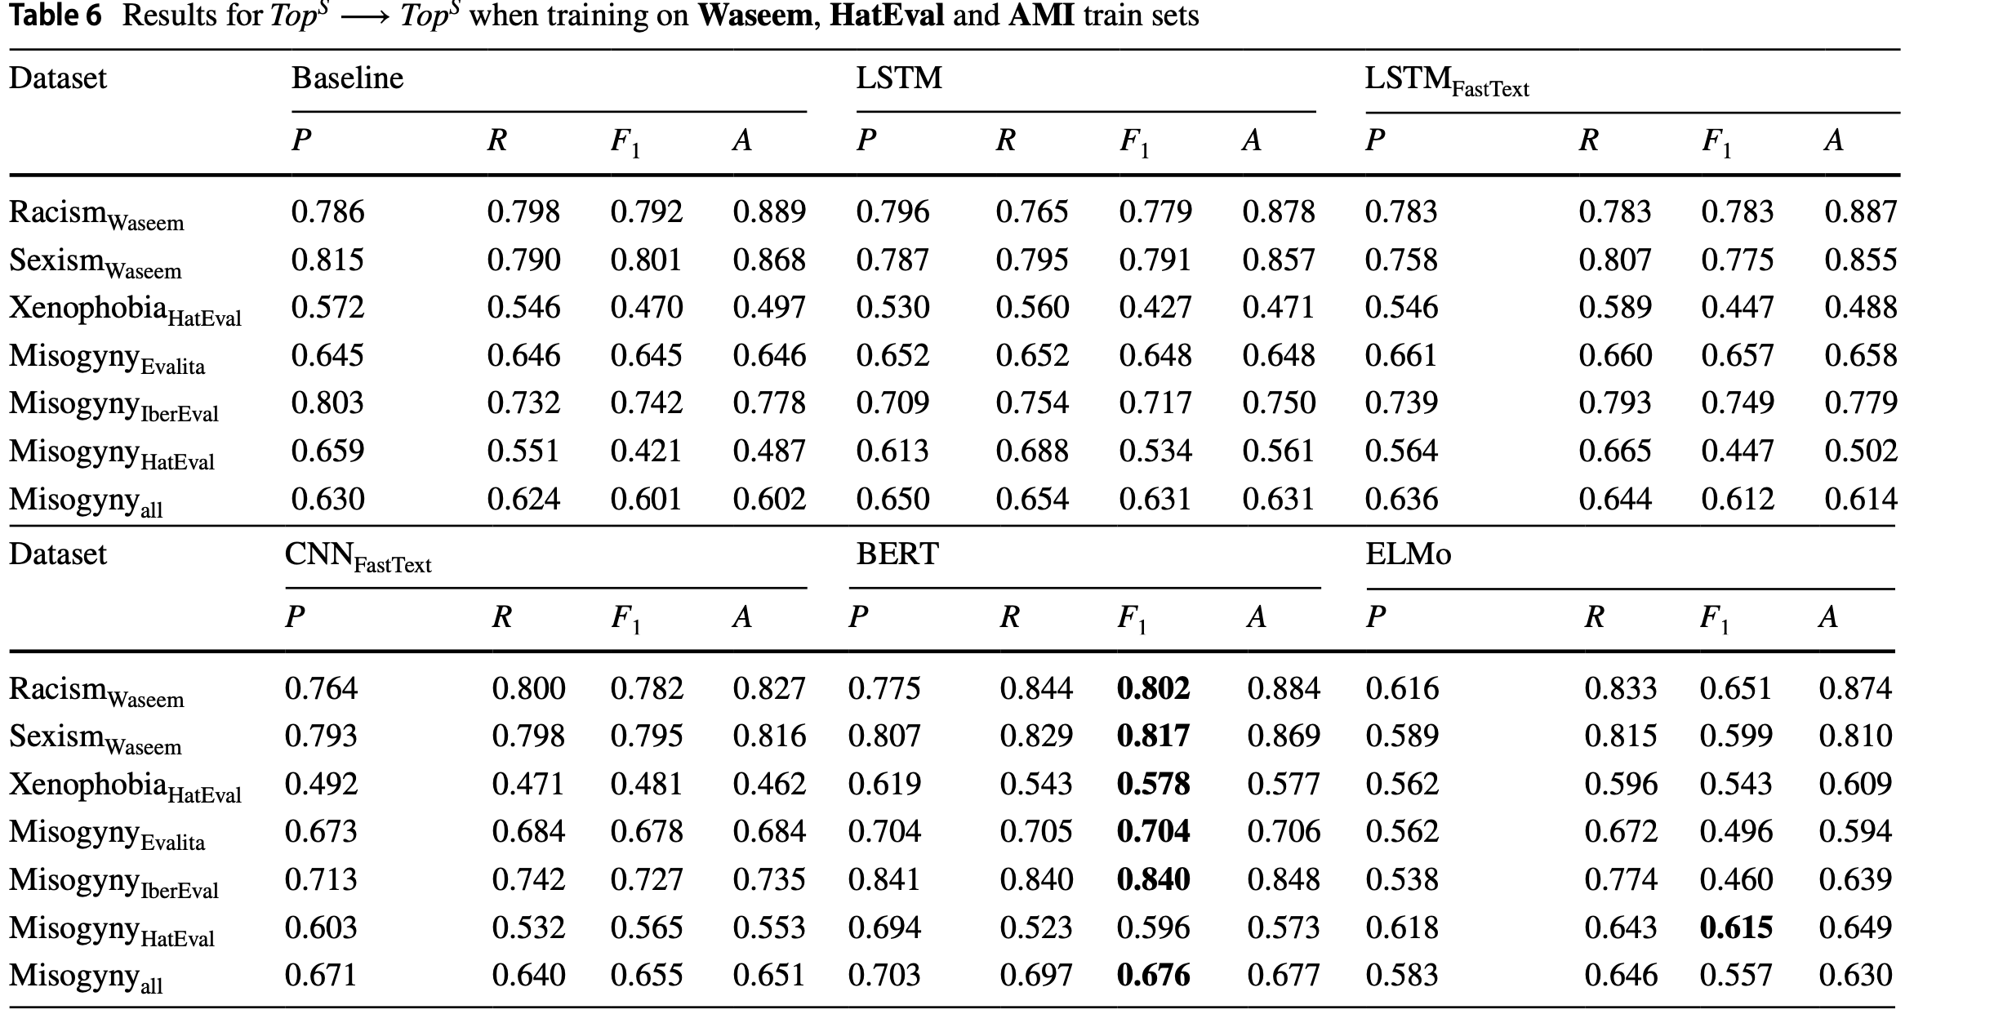
Cross Referencing
“Table 6 presents the results obtained when focusing on learning topic-specific HS properties by combining all training sets of all datasets. The overall picture of the results shows that our baseline (i.e., LSVC) performed quite well when compared to other models: it presents a decrease of anywhere in between 1% and 11% in terms of F1 score, when compared to the best-performing models for a specific topic. …These results confirm that a model trained with a combination of several datasets with different topical focuses is more robust than a model trained on a topic-generic dataset” (Chiril et al., 2021, p.333).
Notes:
When performing keyword identification, it is important to cross reference from a variety of databases in order to get a more holistic view of the data. When using multiple databases, it accounts for variations in terms, as well as certain regional or spelling variations that would have otherwise gone unnoticed by the use of a singular database. Due to the fast evolving nature of online hate speech, it is important to account for a wide variation of languages and dialects.

Slide 11
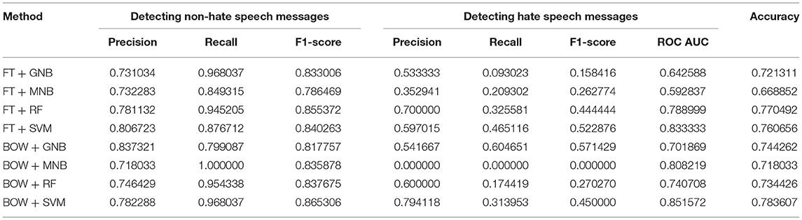
Machine Learning Model for Keyword Recall
“This set of methods was chosen because the methods have been widely applied in text classification tasks and other challenging machine learning tasks, such as spam filtering or document organization…Precision, recall, and the F1-score are presented in table 1” (Laaksonen et al., 2020, p. 8).
Machine learning models have immense capacity for good in terms of recognition of hate speech as they can accurately recall terms and phrases from a wide array of datasets.
Notes:
Machein learning models can be trained to sort through large amounts of data in order to recognize key words and phrases that would thusly identify a post as hate speech.

Slide 12
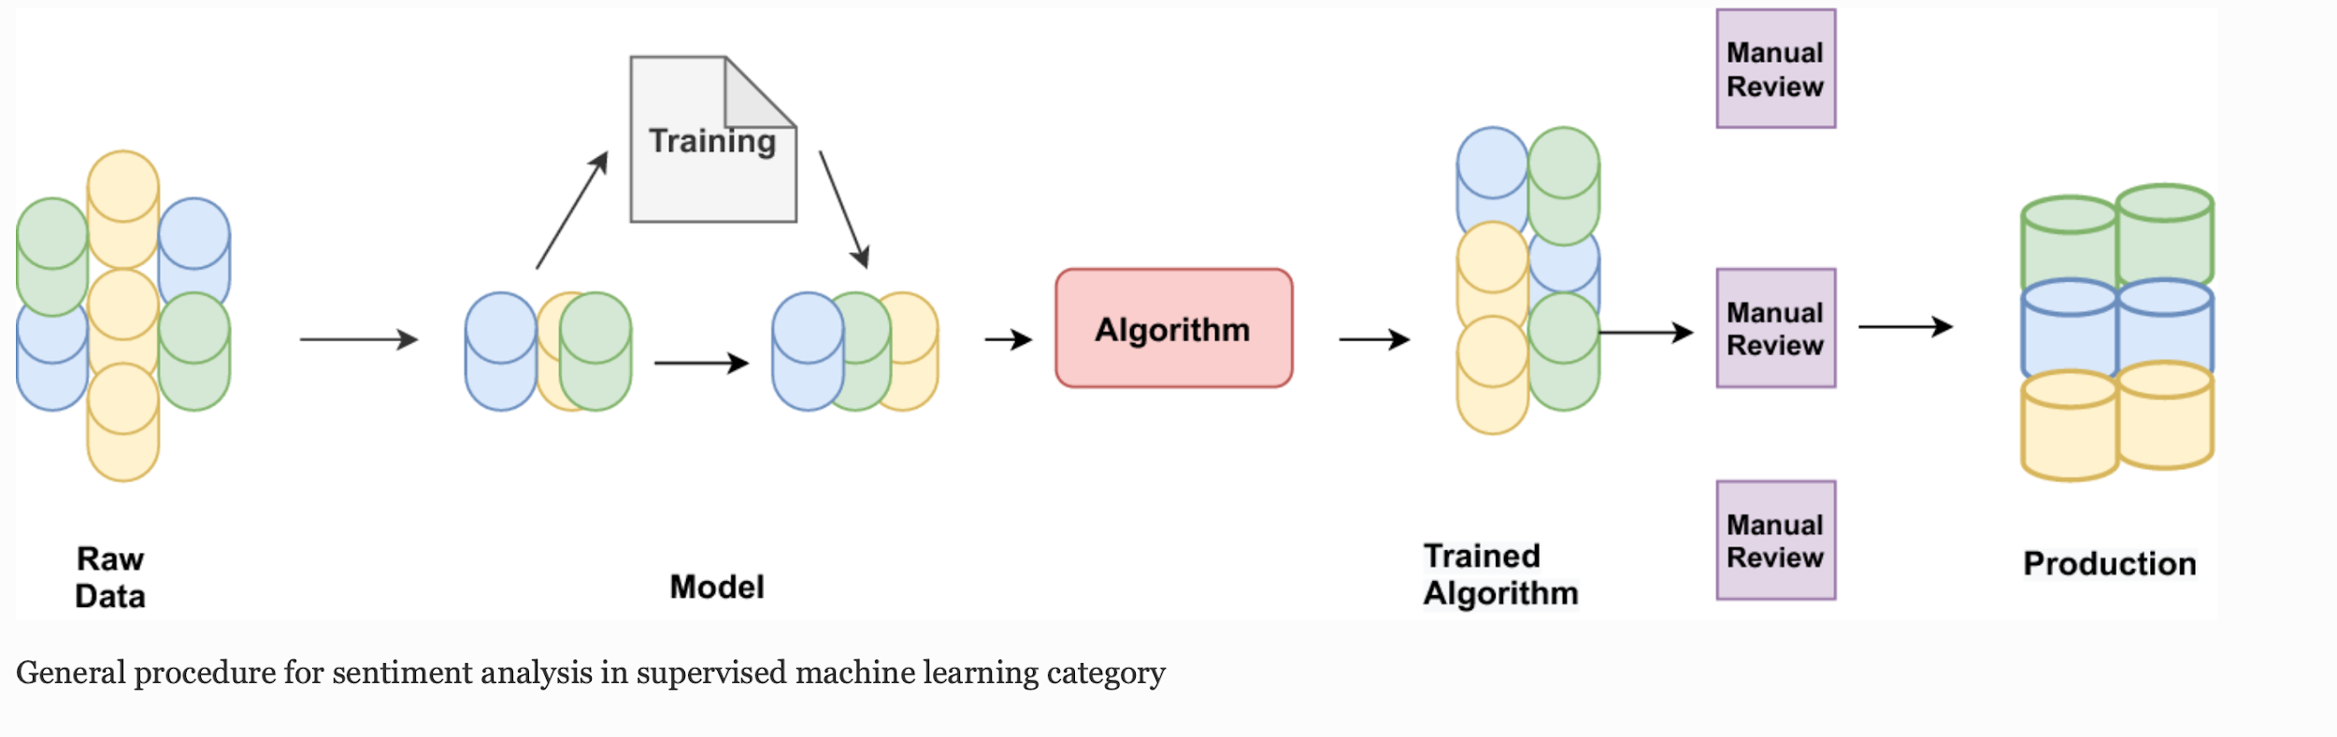
Sentiment Analysis
“The machine learning technique utilizes syntactic and/or linguistic factors to address sentiment classification as a standard text classification issue utilizing syntactic and/or linguistic factors. The categorization model associates the underlying record’s features with one of the class labels. The model is then used to predict a class label for a given instance of an unknown class… Machine learning enables systems to acquire new abilities without being explicitly programmed to do so. Sentiment analysis algorithms can be trained to read beyond simple definitions to comprehend contextual information, sarcasm, and misapplied words” (Wankhade et al., 2020, p. 5750).
Notes:
When analyzing large amounts of textual data, machine learning models can be used to preform sentiment analysis, This method of analysis is used to sort the data into categories based in the perceived emotion of the speaker, granting different values to different terms or phrases depending on their connotative emotional meaning.

Slide 13
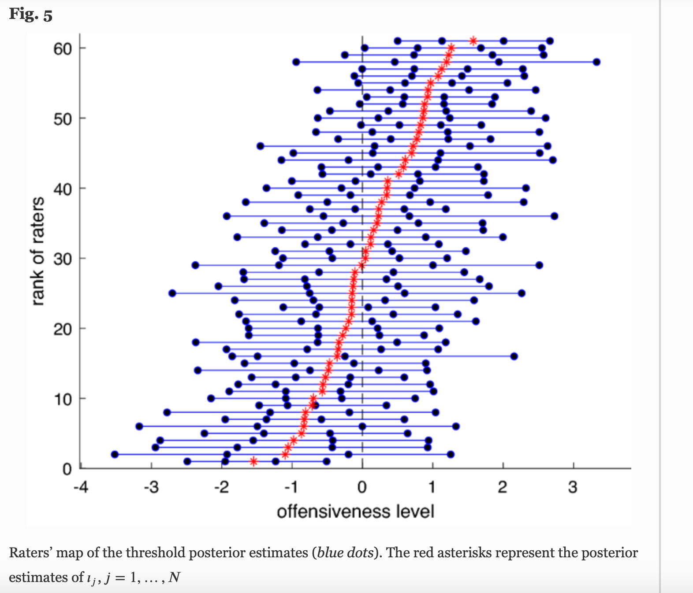
Sentiment Analysis in Practice
“To build a computational lexical resource for offensive and hateful content detection, we used as a starting point the Italian version of Hurtlex. In particular, the building of this computational resource involved the following steps.
The first step consists of removing non-offensive terms and adding potentially offensive terms. Specifically, from the original list, we omitted terms that cannot be used as ‘weapons’
In the second step for each term, we included all the grammatical forms in which they occur. We added singular (masculine and feminine) and plural (masculine and feminine) forms for each noun and adjective.
Finally, in the last step, we graded the offensiveness of each entry. To this end, since determining a given expression’s offensiveness is a highly subjective matter, we decided to create a measurement instrument to be administered to a group of selected respondents” (Tontodimamma et al., 2020, 3.1 Materials section).
“Figure 5 displays the estimated thresholds for all the raters. As can be seen, the distances between consecutive thresholds are not uniform, neither between the raters nor for each rater, and this justifies the use of an item factor analytic model that allows to take into account the different subjective rating systems” (Tontodimamma et al., 2022, 3.3.2 Offensiveness level estimate section).
Notes:
The above outlines sentiment analysis that was performed on a collection of online posts containing hate speech. Utilizing the hurtle database, researchers flagged hate speech in online posts and were able to discern ongoing trends, namely the offensiveness, or intent to harm of the speech used. This sort of analysis proves useful for determining the impact of hate speech, especially when comparing hateful rhetoric to language that is simply cruel in nature.

Slide 14
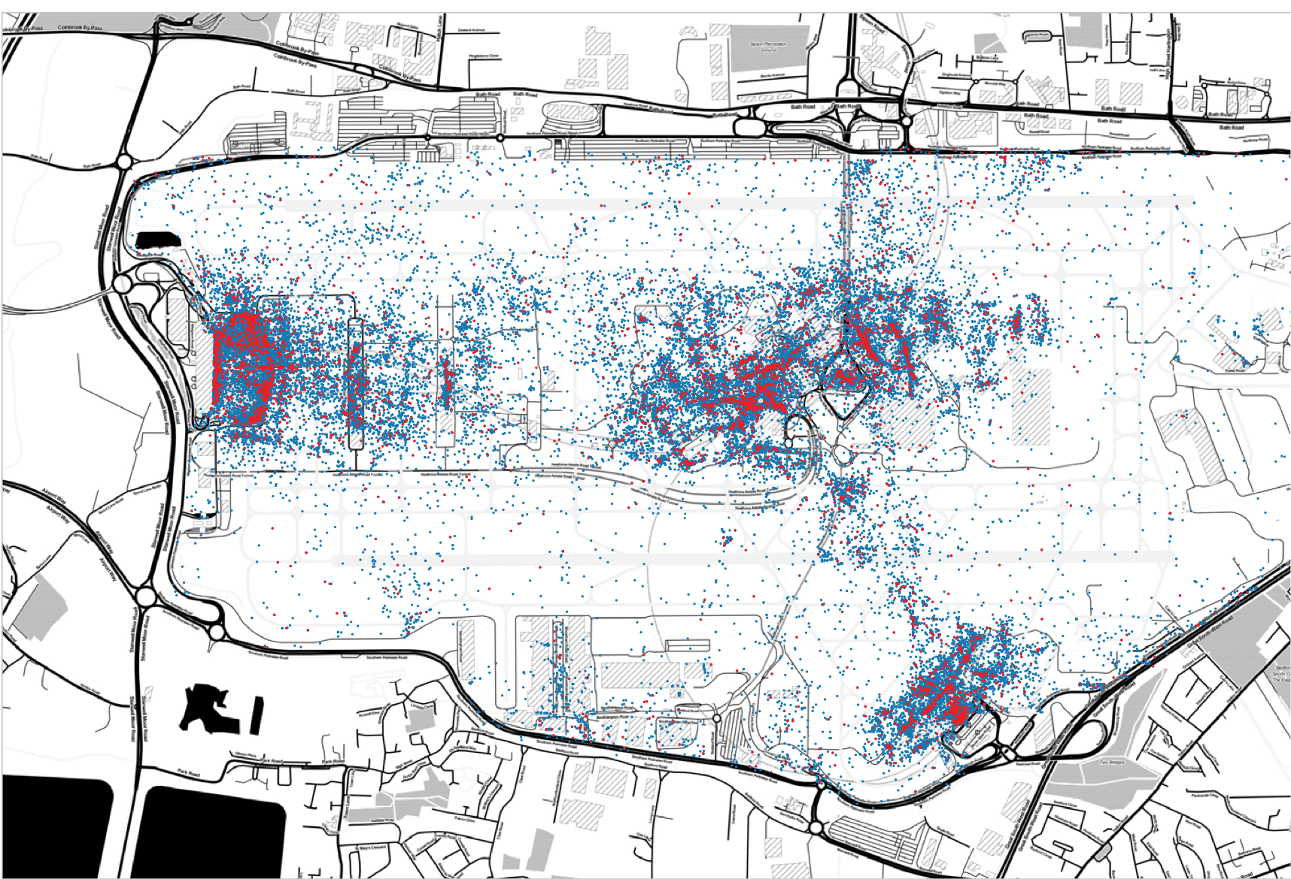
Discerning spatial trends
“Figure 11.6 illustrates the distribution of the Consumers Tweets (red) and the rest of the Tweets from the sample (blue). It can be observed that Tweets from the Consumers topic are very densely concentrated between a handful of locations across the site” (Leak et al., 2018, p. 163).
“Therefore, it is possible that harnessing Twitter data can be useful in identifying activity trends across time and space. These can range from unusual delays to feedback on retail offerings… Looking forwards, analysts can use the probability scores for our database of words to model future data into the pre-existing topic categories in order to identify trends on the fly” (Leak et al., 2018, p. 164).
Notes:
Data gathered from text mining can have usages beyond the mere identification of hateful speech or a hateful speaker. Instead, the data can be used to detect patterns, be they temporal, or spatial. As viewed above, spatial data is often utilized in the field of marketing in which twitter posts are combed and analyzed to discern trends in timing and location. Using similar methods, researchers can apply their knowledge to tweets containing hate speech, in order to use linguistic variations in the speech, and time of posting, in order to gather spatial data. This data can then be used to predict trends of action, and even discern some of the motives and actions of the poster.
Image displays a map of Heathrow Airport, London, United Kingdom.

Slide 15
Questions?

Slide 16
Gathering Subject Data
An overview of the methods, both quantitative and qualitative, involved in gathering participant data.

Slide 17
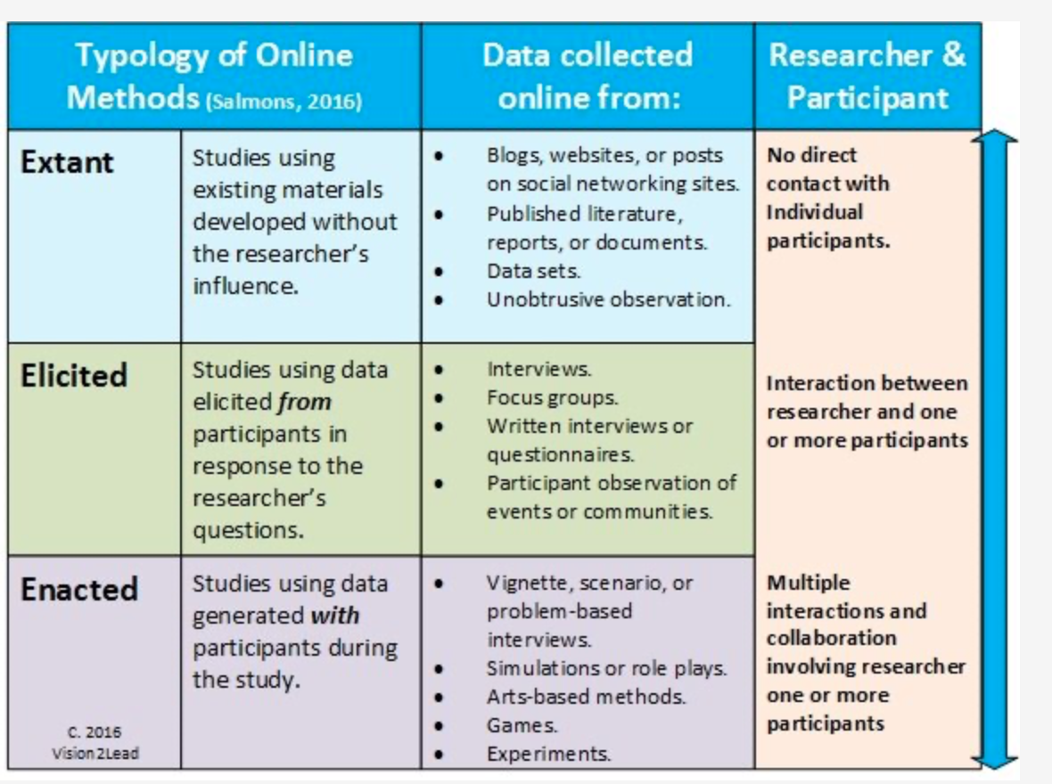
Qualitative methods- Participant observation
“Participant observation to collect data in a process that includes the researchers’ involvement in communications—for example, posting to forums, blogs, or walls in online communities or on social media sites. The researcher responds to others’ posts, engages openly with the group, and might share knowledge gained from study or experience. Participant observers can have both informal discussions or formal interviews with group members” (Sage, n.d.).
Notes:
Participant observation is an effective way at gathering Qualitative data, especially so when the researcher wishes to observe behavior in online spaces. In the context of hate speech research, students should be wary of who they are interacting with, especially due to the volatile nature of those posting. However passive observation of blogs and forums can glean good insight into patterns, motives, and actions of those posting.

Slide 18
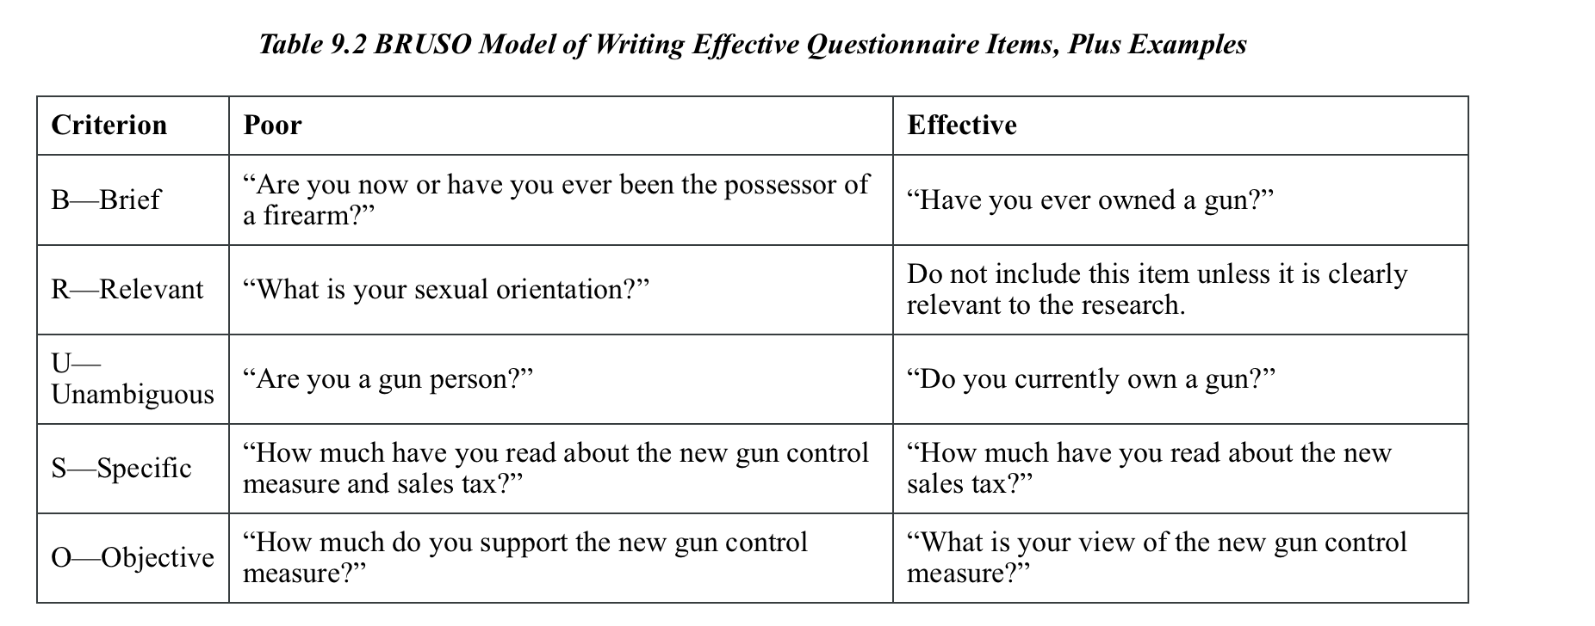
Quantitative methods - Survey
“A rough guideline for writing questionnaire items is provided by the BRUSO model. An acronym, BRUSO stands for “brief,” “relevant,” “unambiguous,” “specific,” and “objective”… The best way to know how people interpret the wording of the question is to conduct pre-tests and ask a few people to explain how they interpreted the question. For closed-ended items, it is also important to create an appropriate response scale. For categorical variables, the categories presented should generally be mutually exclusive and exhaustive” (Jhangiani et al., 2020, p. 193-194)
Notes:
Survey remains an effective way at gathering quantitative data from participants. Though there are many styles of survey questions, students should try to keep in mind the standards outlined above in order to ensure they are asking questions that will garner the best data.

Slide 19
Research Ethics
A summary of the various ethical concerns involved in Hate speech research, and the methods at working around these.

Slide 20
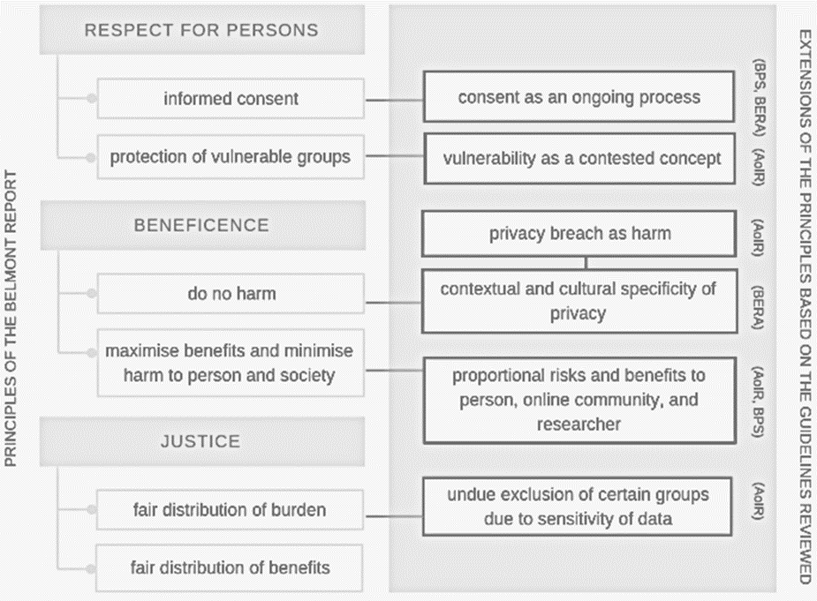
Text Harvesting Ethics
Although U.S. statutes and case law do not prohibit web scraping / text harvesting, it is important to consider the bigger picture of appropriate methods for accessing websites, extracting content, and reusing it for research purposes.
“The current complexities surrounding good practice and Twitter research create significant challenges for ongoing work in the field. … These issues are not specific to Twitter data alone and apply to other forms of Web science research such as those using blogs and forums as data sources in addition to other social media platforms. Furthermore, the challenges we have highlighted have also been discussed in relation to other uses of digital data The fact that they remain unresolved demonstrates how intractable they are.” (Webb et al., 2017)
Image Credit: Anabo, I. F., Elexpuru-Albizuri, I., & Villardón-Gallego, L. (2019). Revisiting the Belmont Report’s ethical principles in internet-mediated research: Perspectives from disciplinary associations in the social sciences. Ethics and Information Technology, 21(2), 137-149.
Notes:
Though using online platforms as a means for gathering data is fairly new, literature is already circulating regarding the ethics behind text gathering, and how to best go about preserving the privacy of those whose data researchers are collecting. Though opinions vary, there is a united emphasis on the need to preserve participant privacy, be it through gaining explicit consent before text mining, or else omitting user names and details while doing the research.

Slide 21
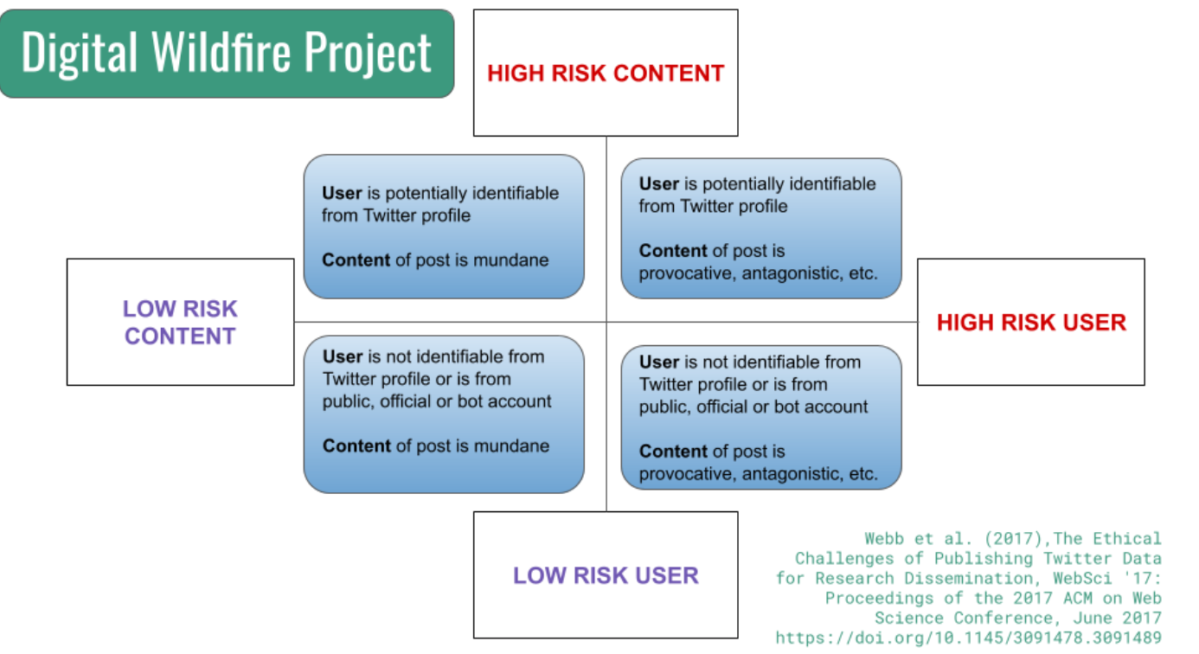
Methods of preserving confidentiality
“Given that the project included examination of hate speech, there was concern that harm may come to identifiable users who posted content considered to be hateful or inflammatory” (Samberg & Vollmer, 2021, p. 190).
Notes:
One means at preserving participant confidentiality is by assessing the risk of attributing a user’s identity to specific content. In the context of those speaking and those receiving hate speech this method of risk assessment can prove useful as it can provide researchers with insight on a case by case basis. Once risk is assessed, researchers can employ strategies such as omitting poster name, or using an alias as to hide a poster’s identity.

Slide 22
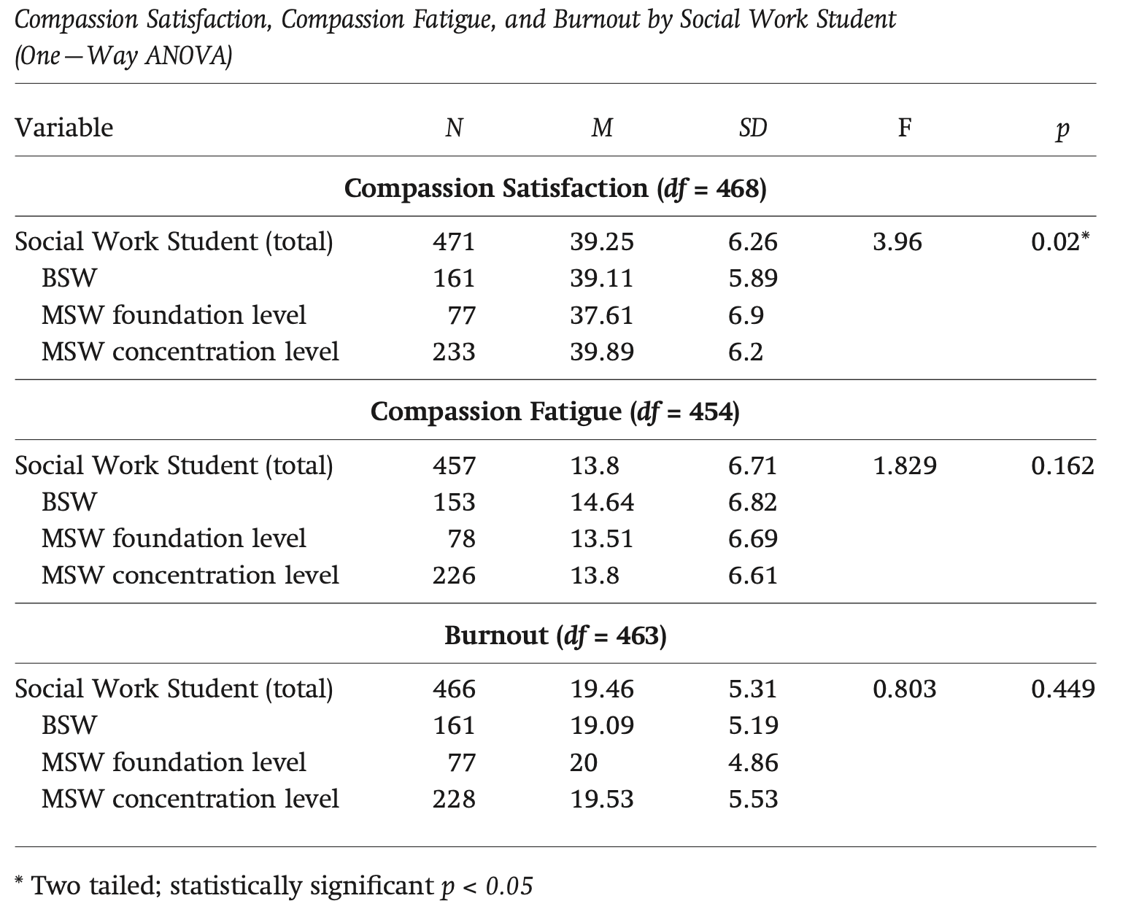
Compassion fatigue
“The average compassion fatigue score is 13 (SD = 6), whereas the study respondents had an average compassion fatigue score of 14.61 (SD = 6.961), indicating the study respondents reported slightly higher levels of compassion fatigue than national respondents. … Social work students who reported higher levels of burnout had higher levels of compassion fatigue. We found a statistically significant negative relationship between burnout and compassion satisfaction (r = −0.489, p < 0.01). Social work students who reported high levels of burnout had lower levels of compassion satisfaction” (Harr, 2014, p. 242).
The results of the studies show the susceptibility students have, even at the undergraduate level, for developing compassion fatigue from their interaction with patients.
Notes:
Compassion fatigue is highly prevalent in professions which require one to be in close proximity to the trauma of others. Its symptom mimics that of PTSD, including increased sense of worry and apathy which inevitably harms one's job performance and overall well being. Despite not being out in the field, students who do work related to trauma are also at risk of developing compassion fatigue.

Slide 23
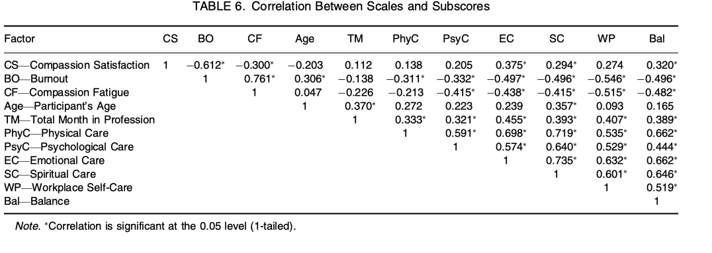
Combating compassion fatigue
“It was also interesting to note that compassion satisfaction was significantly positively correlated with the emotional, spiritual, and balance subscales of the SCAW but not the physical, psycho- logical, and workplace subscales. This could suggest that while engaging in a variety of self-care strategies may prevent burnout and compassion fatigue, only emotional and spiritual self-care, and personal-professional balance are predictive of higher levels of compassion satisfaction” (Alkema, 2008, p. 114).
Notes:
While self care proves to be an effective method at combating compassion fatigue, giving students the told to establish a work/life balance better equips them to recognize, combat, and even prevent compassion fatigue. By integrating wellness into education early on, students can lay the groundwork for healthier practices that will inevitable aid them in the long run.

Slide 24
Questions?

Slide 25
Activity
Here you will study the real world posts of individuals who circulate hate speech.
Choose one of the available online platforms and enter as a passive observer. After spending a few minutes observing the platform, make some observations about the sort of language you encounter, using the database Hatebase to define any terms you are unfamiliar with.
As you complete the exercise, follow the questions outlined below, or come up with your own. You want to try and come up with a simple profile of these individuals, and use the data available to get a better sense of their mental state, and motives.
Notes:
Assignment 2 - Online Observation is the intended activity described here. If preferred, Assignment 1 - Coded Language can be used here instead - it is available on the next slide and can be accessed by un-skipping the slide.

Slide 26
Activity
Using the database, Hatebase, students will be asked to examine fragments of language from existing conflicts from around the world.
Using the terms compiled in the database, students should be able to distinguish which fragments of language constitute hate speech, identify who the speech is intended to target, and what sort of damage the speech inflicts upon its recipients.
Students should take notes of their findings and prepare to report to the class.
Notes:
Assignment 1 - Coded Language is the intended activity described here. This slide can be accessed and made visible in slideshow mode by unskipping it.

Slide 27
Works Cited
Ackland, R., O'Neil, M., Standish, R. K., & Buchhorn, M. (2006). VOSON: A Web services approach for facilitating research into online networks.
Alkema, K., Linton, J. M., & Davies, R. (2008). A study of the relationship between self-care, compassion satisfaction, compassion fatigue, and burnout among hospice professionals. Journal of Social Work in End-Of-Life & Palliative Care, 4(2), 101–119. https://doi.org/10.1080/15524250802353934
Anabo, I. F., Elexpuru-Albizuri, I., & Villardón-Gallego, L. (2019). Revisiting the Belmont Report’s ethical principles in internet-mediated research: Perspectives from disciplinary associations in the social sciences. Ethics and Information Technology, 21(2), 137-149.
Chahal, K. (2017). Hate in a Digital World. In Supporting victims of hate crime: A practitioner guide (1st ed., pp. 19–28). Bristol University Press https://doi.org/10.2307/j.ctt1t8904s.6
Ethics evaluation of the Digital Wildfire Project in Webb et al. (2017), The Ethical Challenges of Publishing Twitter Data for Research Dissemination, WebSci ’17: Proceedings of the 2017 ACM on Web Science Conference, June 2017. https://doi.org/10.1145/3091478.3091489
Laaksonen, S. M., Haapoja, J., Kinnunen, T., Nelimarkka, M., & Pöyhtäri, R. (2020). The datafication of hate: Expectations and challenges in automated hate speech monitoring. Frontiers in Big Data, 3. https://doi.org/10.3389/fdata.2020.00003
Leak, A., Lansley, G., Longley, P., Cheshire, J., & Singleton, A. (2018). Geotemporal Twitter Demographics. In Consumer Data Research (pp. 152–165). UCL Press. https://doi.org/10.2307/j.ctvqhsn6.14
Harr, C. R., Brice, T. S., Riley, K., & Moore, B. (2014). The Impact of Compassion Fatigue and Compassion Satisfaction on Social Work Students. Journal of the Society for Social Work and Research, 5(2), 233–251. https://doi.org/10.1086/676518
Jhangiani, R. S., Chiang, I. A., Cuttler, C., and Leighton, D. C. (2020) Research Methods in Psychology. (4th ed.) Kwantlen Polytechnic University. https://kpu.pressbooks.pub/psychmethods4e/
Ondrejková, N., & Halamová, J. (2022). Prevalence of compassion fatigue among helping professions and relationship to compassion for others, self-compassion and self-criticism. Health & Social Care in the Community, 30, 1680– 1694. https://doi.org/10.1111/hsc.13741
Saha, K., Chandrasekharan, E., & De Choudhury, M. (2019). Prevalence and psychological effects of hateful speech in online college communities. Proceedings of the ... ACM web science conference. ACM Web Science Conference, 2019, 255–264. https://doi.org/10.1145/3292522.3326032
Sage. (n.d.) Participant observation: How does it work online?. Methodspace. https://www.methodspace.com/blog/participant-observation-how-does-it-work-online
Samberg, R. G., & Vollmer, T. (2021). Building legal literacies for text data mining. University of California, Berkeley. https://escholarship.org/content/qt2vw807vb/qt2vw807vb.pdf
Stamou, V., Alexiou, I., Klimi, A., Molou, E., Saivanidou, A., & Markantonatou, S. (2022) Cleansing and expanding the HURTLEX(EL) with a multidimensional categorization of offensive word. Proceedings of the Sixth Workshop on Online Abuse and Harms (WOAH), pp. 102-108. https://aclanthology.org/2022.woah-1.10.pdf
Tontodimamma, A., Fontanella, L., Anzani, S., & Basile, V. (2022). An Italian lexical resource for incivility detection in online discourses. Quality & Quantity. https://doi.org/10.1007/s11135-022-01494-7
Wankhade, M., Rao, A. C., & Kulkarni, C. (2022). A survey on sentiment analysis methods, applications, and challenges. Artificial Intelligence Review, 55(7), 5731–5780. https://doi.org/10.1007/s10462-022-10144-1

